Slide 1
Gold price prediction
Using random forest regression

Slide 2
introduction
Gold is one of the precious metals. It has been used as currency, for jewelry and other purposes. It is used as medium for money or exchange because of its limited supply and high value
. It also reflects the country’s economic strength and hence many companies and individuals started to invest in gold reserves. Due to its increasing value, many people considered gold as an attractive investment.
s. Since gold is stored and accumulated over years, the influence of an year’s production on its price is less. The price of gold depends on currency fluctuations and other economic variables. The raise of gold prices and fall of prices in other markets has attracted more investors to invest in gold market. These changes in the price of gold made the investments risky and a fear has been developed that these prices would decrease.

Slide 3
aim
In this project, we shall analyze and predict the upcoming prices of Gold, using Machine Learning’s Random Forest Regressor algorithm

Slide 4
objectives
The Project titled 'GOLD PRICE PREDICTION' predicts the gold's price based on:
Date — mm/dd/yyyy
SPX — is a free-float weighted measurement stock market index of the 500 largest companies listed on stock exchanges in the United States.
GLD — Gold Price
USO — United States Oil Fund
SLV — Silver Price
EUR/USD — currency pair quotation of the Euro against the US

Slide 5
scopes
1.This project is based on the applicability of the proposed machine learning algorithms that had demonstrated their efficiency to predict gold prices with a better predictive rate.
2. To apply the best appropriate Machine Learning procedure.
3. We proposed the development of a prediction model for predicting future gold prices using Random forest regressor

Slide 6
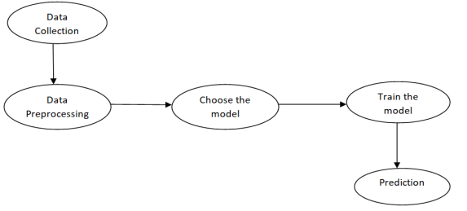
How do we predict gold prices?
To predict the gold price, we need to build a machine learning model which includes the following steps.

Slide 7
Data collection
The first thing required while building a machine learning model is the data. The data is collected from kaggle website consisting of 2290 rows and 6 columns of data.

Slide 8
Data preprocessing
Data preprocessing is required when the data is incomplete, inconsistent or noisy. The data collected was noisy, so we performed outlier analysis and removed the noisy data. The data transformation is also done by performing normalization in which the data in each attribute is scaled between the range 0 to 1.

Slide 9
Choosing the model
Prediction of gold price is a regression task, so we consider the regression algorithms such as Multiple Linear Regression, Random Forest Regressor and Gradient Boosting for building the model.

Slide 10
Training the model
The model is trained by importing the required model and by passing the training data to it. The dataset is splitted into train and test data with test_size=0.20. The linear model is imported from sklearn and the Random forest regressor and Gradient boosting regressor modules are imported from sklearn.ensemble. These models are trained by passing the train data. While conducting training, it is also important to record the metrics of each training process. The metrics that are tested are mean absolute error, root mean square error and r2 score.( this has to be changed)

Slide 11
prediction
The trained model is checked by predicting the test data of the dependent variable using the test data of the independent variables.

Slide 12
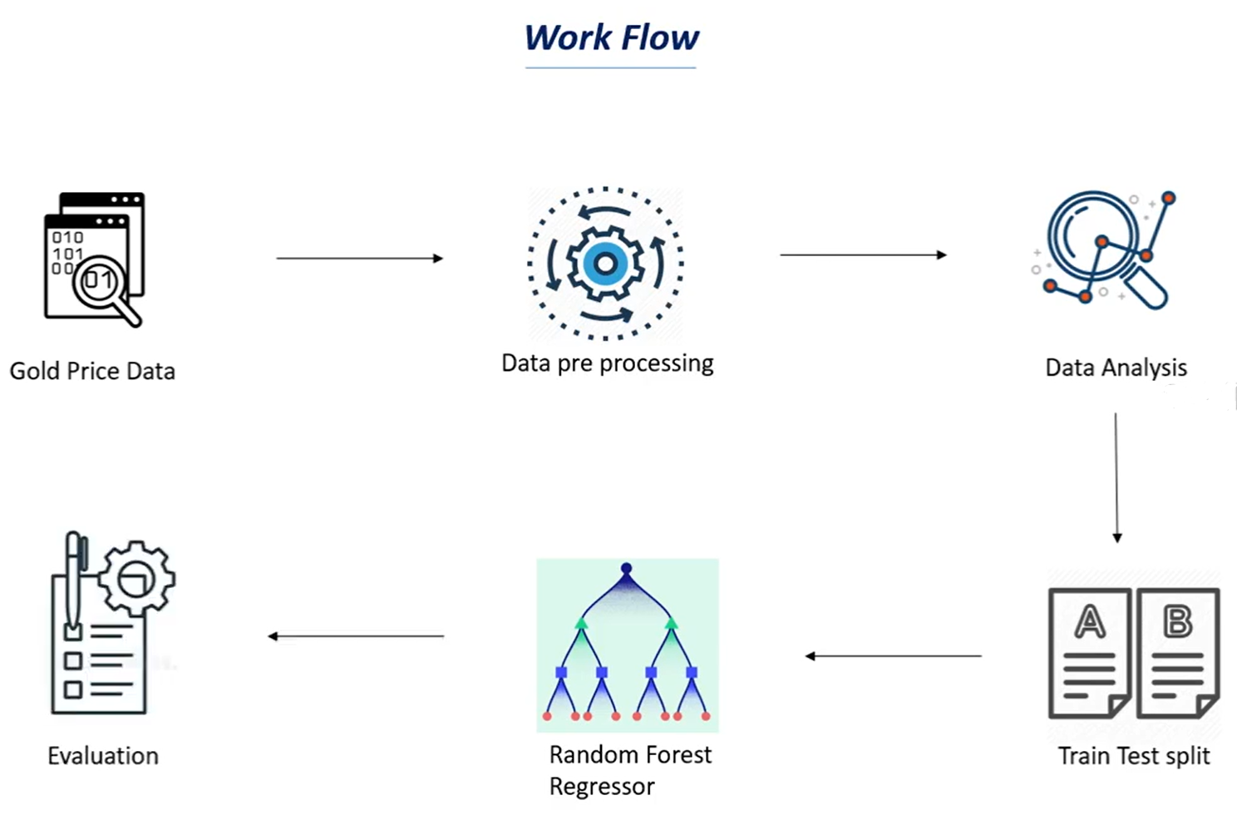

Slide 13
Gold price data
gold prices are provided by several data feed providers, in the event that there is a failure in one data feed provider we switch to one of our other providers.
Gold prices are sometimes referred to as world gold prices, New York gold prices, spot gold prices, gold market prices and gold bullion prices. These prices are indications of the current trading prices for one troy ounce of gold on the various world exchanges.
This price is quoted in US dollars. Where the gold price is displayed in currencies other than the US dollar, it is converted into the local currency.
Like all prices, the gold price reflects not only the inherent value of gold, but also the relative strength of the currency in which it is quoted. For example, the dollar price of gold may increase more in percentage terms than the Euro price of gold, to the extent that the change in price is a reflection of dollar weakness (in this case, against Euros) rather than an intrinsic change in gold market fundamentals.

Slide 14
Data preprocessing
Data preprocessing is required when the data is incomplete, inconsistent or noisy. The data collected was noisy, so we performed outlier analysis and removed the noisy data. The data transformation is also done by performing normalization in which the data in each attribute is scaled between the range 0 to 1.

Slide 15
Analysing the data. We shall analyze the data depending on the terms we need:
Date — mm/dd/yyyy
SPX — is a free-float weighted measurement stock market index of the 500 largest companies listed on stock exchanges in the United States.
GLD — Gold Price
USO — United States Oil Fund
SLV — Silver Price
EUR/USD — currency pair quotation of the Euro against the US

Slide 16
Train test split
Split the data into target values and feature values :
X = gold_data.drop(['Date','GLD'],axis=1) Y = gold_data['GLD']
As there were no empty cells, we could readily begin with the table manipulations;
Here, X is the feature variable, containing all the features like SPX, USO, SLV, etc., on which the price of gold depends, excluding the GLD and Date column itself.
Y, on the other hand, is the target variable, as that is the result that we want to determine,i.e, the price of Gold. (It contains only the GLD column)

Slide 17
Train test split
Splitting X and Y into training and testing variables :
Now, we will be splitting the data into four variables, viz., X_train, Y_train, X_test, Y_test.
X_train, X_test, Y_train, Y_test = train_test_split(X, Y, test_size = 0.2, random_state=2)
Let’s understand the variables by knowing what type of values they store :
X_train: contains a random set of values from variable ‘ X ‘
Y_train: contains the output (the price of Gold) of the corresponding value of X_train.
X_test: contains a random set of values from variable ‘ X ‘, excluding the ones from X_train( as they are already taken).
Y_train: contains the output (the price of Gold) of the corresponding value of X_test.
test_size: represents the ratio of how the data is distributed among X_trai and X_test (Here 0.2 means that the data will be segregated in the X_train and X_test variables in an 80:20 ratio). You can use any value you want. A value < 0.3 is preferred

Slide 18
Random forest regression
Random Forest is a popular machine learning algorithm that belongs to the supervised learning technique. It can be used for both Classification and Regression problems in ML. It is based on the concept of ensemble learning, which is a process of combining multiple classifiers to solve a complex problem and to improve the performance of the model.
As the name suggests, "Random Forest is a classifier that contains a number of decision trees on various subsets of the given dataset and takes the average to improve the predictive accuracy of that dataset." Instead of relying on one decision tree, the random forest takes the prediction from each tree and based on the majority votes of predictions, and it predicts the final output.
The greater number of trees in the forest leads to higher accuracy and prevents the problem of overfitting.

Slide 19

The working of the algorithm can be better understood by the below example:
Suppose there is a dataset that contains multiple fruit images. So, this dataset is given to the Random forest classifier. The dataset is divided into subsets and given to each decision tree. During the training phase, each decision tree produces a prediction result, and when a new data point occurs, then based on the majority of results, the Random Forest classifier predicts the final decision

Slide 20
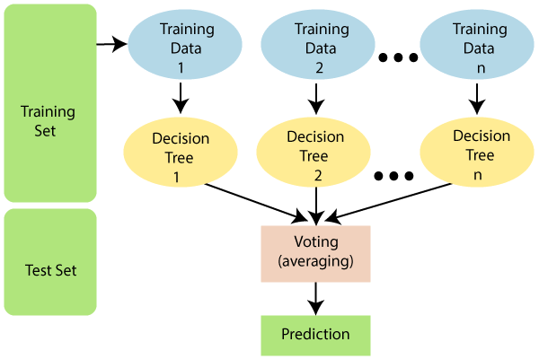
Random forest regression

Slide 21
Assumptions of random forest
Since the random forest combines multiple trees to predict the class of the dataset, it is possible that some decision trees may predict the correct output, while others may not. But together, all the trees predict the correct output. Therefore, below are two assumptions for a better Random forest classifier:
There should be some actual values in the feature variable of the dataset so that the classifier can predict accurate results rather than a guessed result.
The predictions from each tree must have very low correlations.

Slide 22
Why do we use random forest regression
Below are some points that explain why we should use the Random Forest algorithm:
It takes less training time as compared to other algorithms.
It predicts output with high accuracy, even for the large dataset it runs efficiently.
It can also maintain accuracy when a large proportion of data is missing.

Slide 23
How does Random Forest algorithm work?
Random Forest works in two-phase first is to create the random forest by combining N decision tree, and second is to make predictions for each tree created in the first phase.
The Working process can be explained in the below steps and diagram:
Step-1: Select random K data points from the training set.
Step-2: Build the decision trees associated with the selected data points (Subsets).
Step-3: Choose the number N for decision trees that you want to build.
Step-4: Repeat Step 1 & 2.
Step-5: For new data points, find the predictions of each decision tree, and assign the new data points to the category that wins the majority votes.

Slide 24
Why do we use random forest ?
Miscellany: Each tree has a unique attribute, variety and features concerning other trees. Not all trees are the same.
Immune to the curse of dimensionality: Since a tree is a conceptual idea, it requires no features to be considered. Hence, the feature space is reduced.
Parallelization: We can fully use the CPU to build random forests since each tree is created autonomously from different data and features.
Train-Test split: In a Random Forest, we don’t have to differentiate the data for train and test because the decision tree never sees 30% of the data.
Stability: The final result is based on Bagging, meaning the result is based on majority voting or average.

Slide 25
Applications of Random Forest
There are mainly four sectors where Random forest mostly used:
Banking: Banking sector mostly uses this algorithm for the identification of loan risk.
Medicine: With the help of this algorithm, disease trends and risks of the disease can be identified.
Land Use: We can identify the areas of similar land use by this algorithm.
Marketing: Marketing trends can be identified using this algorithm.

Slide 26
Advantages of Random Forest
Random Forest is capable of performing both Classification and Regression tasks.
It is capable of handling large datasets with high dimensionality.
It enhances the accuracy of the model and prevents the overfitting issue.
Disadvantages of Random Forest
Although random forest can be used for both classification and regression tasks, it is not more suitable for Regression tasks.

Slide 27
evaluation

